Slide 1


REAL-TIME GENDER CLASSIFICATION
Group Members :
Pooja Mishra (17IT1082)
Siddhant Gangawane (15IT1066)
Neha Singh (17IT2012)

Slide 2

CONTENTS OF THIS PRESENTATION
INSTRUCTION
PROBLEM DEFINITION
01
A little introduction of project title and group.
03
Problem statement and proposed framework of the project.
MOTIVATION
LITERATURE SURVEY
02
Objective and motivation of the project.
04
Surveys and block diagram and conclusions of the project.

Slide 3


INSTRUCTION
This project focuses on the matter of gender classification for a picture.
Sexual orientation plays crucial parts in social interactions.
The number of picture uploads to the Internet has risen at an almost unprecedented pace over the last decade.
This new discovered abundance of data has allowed computer scientists to solve previously either irrelevant or unsolvable machine vision issues.

Slide 4

Frameworks for this application have a diverse range and scope for significant effects.
The first major area of research in this project is refinement of several previously written, effective frameworks used for the classification of gender .
Within this project, the primary fundamental area of innovation is the modification of a few already published, popular prototypes used for sexual preference classification.
Motivation

Slide 5
HOW DO WE DO IT ?
Problem statement
Lack of performance of current methods on real-world photographs, as compared to the enormous performance strides recently recorded for the related face recognition mission.
Creating efficient, precise frameworks for tasks of gender distinction for a high rate of accuracy .
There is recognition of only two type of genders.
CNNs have recently been analyzed for unconstrained gender classification, and they reported that the efficiency of the CNN-based gender classification system outperformed previous methods.

Slide 6
Methodology

Slide 7

Literature survey
Amit dhomne , Ranjit Kumar , Vijay Bhan
Gender Recognition through face using deep learning
VGGNet Architecture
Accuracy is 95%
Human Gender
classification using
machine learning
Miss. Vaishnavi Y Mali, Dr.Babasaheb G Patil
Accuracy is 78.34%
Support Vector Machine
Khalil Khan, Muhammad Attique,
Ikram Syed,
Asma Gu
Automatic gender classification through face segmentation
GC-MSFS-CRFs
Accuracy is 91.4%
Shubham Patil, Bhagyashree Patil,
Ganesh Tatkare ,
Prof. Saumya Salian
Gender recognition and age approximation using Deep learning techniques
Accuracy is 89.5%
CNN
Roberto Lopez- Santillan,
Luis Carlos Gonzalez- Gurrola,
Graciela Ramirez- Alonso
Gender Classification in author profiling task
AP, NB, SVM, RF
Accuracy is 78.85%
Deep expectation of gender and age from a single image without
facial landmark
Rasmus Rothe, Radu Timofte,
Luc Van Gool
Accuracy is -----
DEX
Safaa Azzakhnini, Lahoucine Ballihi, Driss Aboutajdine
Combining Facial Parts For Learning Gender, Ethnicity, and Emotional State
SVM and Adaboost for binary classification
Accuracy is -----

Slide 8
BLOCK DIAGRAM
First Phase: image preprocessing
Input image dataset FG- net
Gray image
Noise removable
Clipping process
Image size normalization
Face detection
Second Phase: Data Mining Process
Classifier model (J48)
Test 20%
Feature Selection
Feature extraction
Predication rules
Train 80%
Third Phase: Gender estimation and evaluation
Gender Classification
Gender Prediction

Slide 9

Implementation
FIG : Training the model

Slide 10
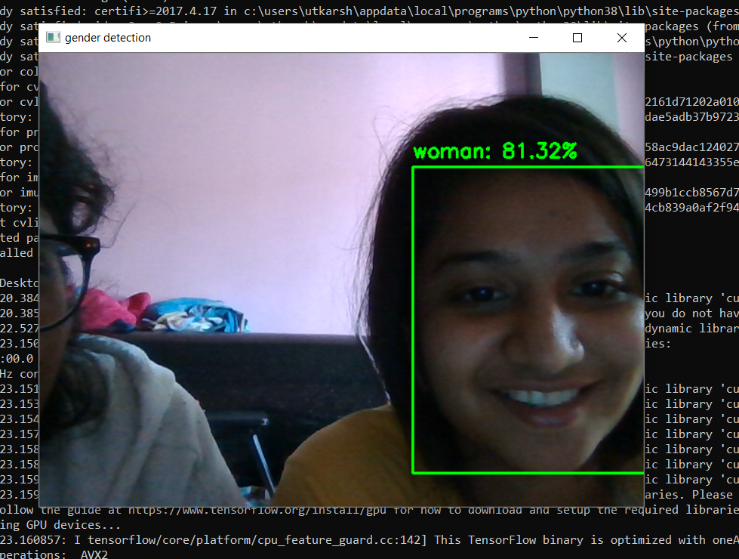
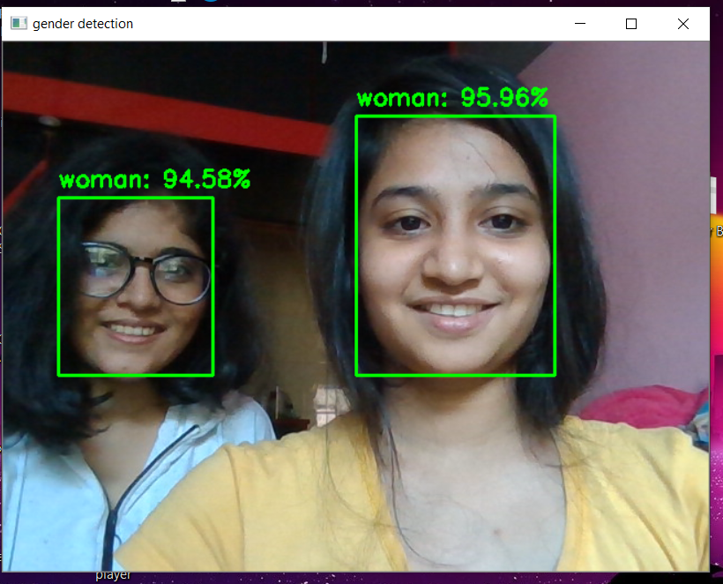
Screenshots

Slide 11
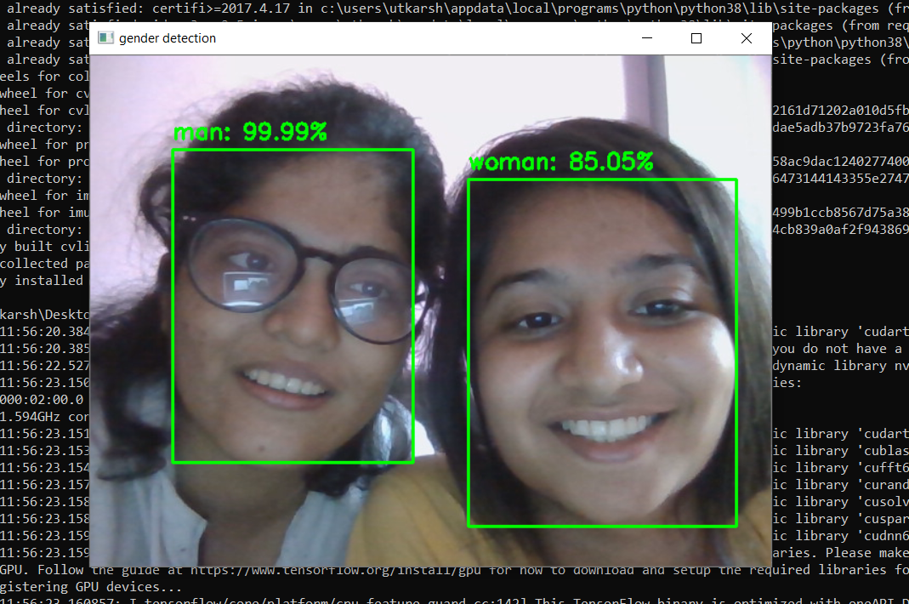
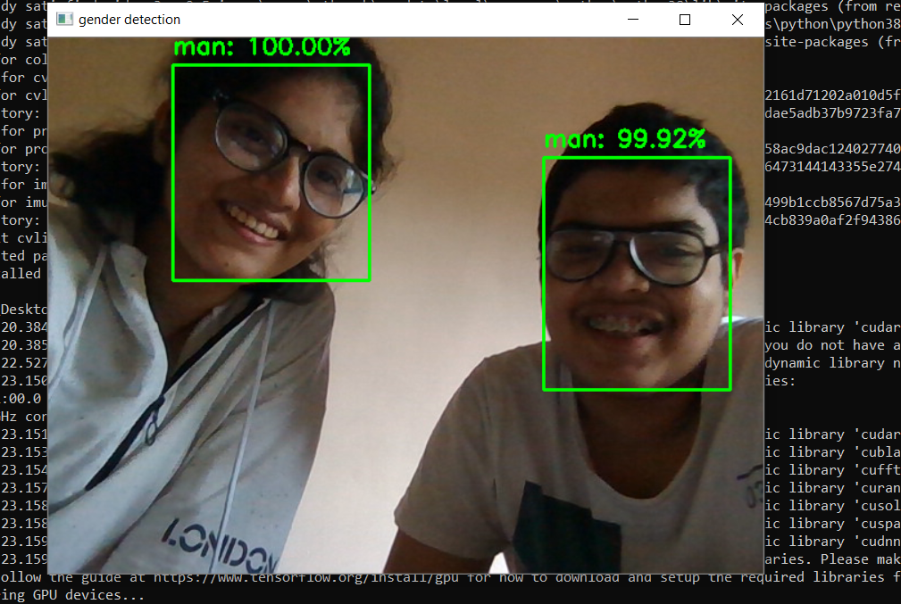

Slide 12

Conclusion and Future-scope
The real time feature can help us to implement this project in many fields.
This can be used in places where we need instant access to the number of men and women present in that particular place for survey and implementation of different projects.
Further this can be used to create an alarm where particular gender is not allowed to enter.
In future we can also add the transgender recognition as now we have three genders to look out for.

Slide 13
THANK
YOU !

